Slide 1



Slide 2


Descriptive Analytics:
Descriptive analytics is the interpretation of historical data to better understand changes that have happened in a business.
Descriptive analytics describes the past using a range of data to draw comparisons.
Most commonly reported financial metrics are a product of descriptive analytics, e.g., year over year pricing changes,month-over-month sales growth, the number of users, or the total revenue per subscriber.
These all describe what has occurred in the business in the time period being measured.

Slide 3


Peep at Your Data :
Import the libraries as
Read the csv(comma separated values) file using pandas.
We can review the first 5 rows of our data using the head( ) function on the pandas DataFrame.

Slide 4
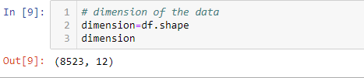
Dimensions of Your Data:
Too many rows and algorithms may take too long to train. Too few and perhaps you do not have enough data to train the algorithms.
Too many features and some algorithms can be distracted or suffer poor performance due to the curse of dimensionality.
We can review the shape and size of your dataset by printing the shape property on the pandas DataFrame.
.

Slide 5
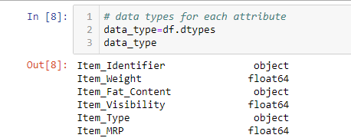
Data Type For Each Attribute:
The type of each attribute is important.
Strings may need to be converted to floating point values or integers to represent categorical or ordinal values.
We can get an idea of the types of attributes by peeking at the raw data, as above. You can also list the data types used by the DataFrame to characterize each attribute using the dtypes property.

Slide 6
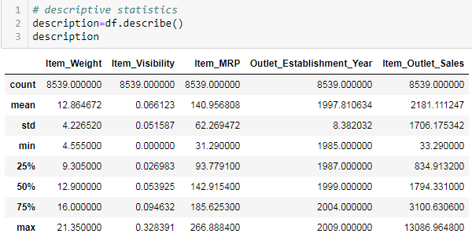
Descriptive Statistics:(summary)
It can give you great insight into the shape of each attribute.
The describe() function on the Pandas DataFrame lists 8 statistical properties of each attribute:

Slide 7
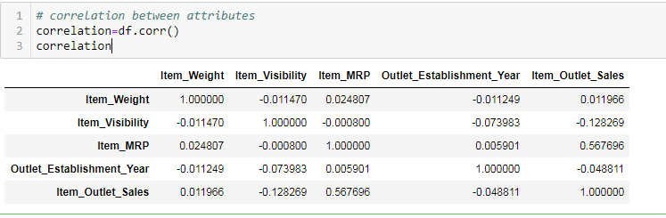
Correlation Between Attributes:
Correlation refers to the relationship between two variables
We can use the corr() function on the Pandas DataFrame to calculate a correlation matrix.

Slide 8
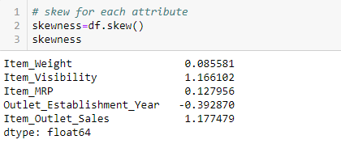
Skew of Univariate Distributions:
Skewness is asymmetry in a statistical distribution, in which the curve appears skewed either to the left or to the right.
We can calculate the skew of each attribute using the skew() function on the Pandas DataFrame.

Slide 9
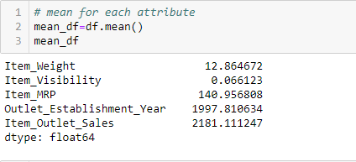
Mean:
Mean can be used to calculate average of a given list of numbers. It returns mean of the data set passed as parameters.
We can calculate the mean of each attribute using the mean() function on the Pandas DataFrame.

Slide 10
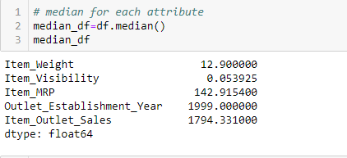
Median:
Median can be used to calculate median value from an unsorted data-list.
The biggest advantage of using median() function is that the data-list does not need to be sorted before being sent as parameter to the median() function.

Slide 11
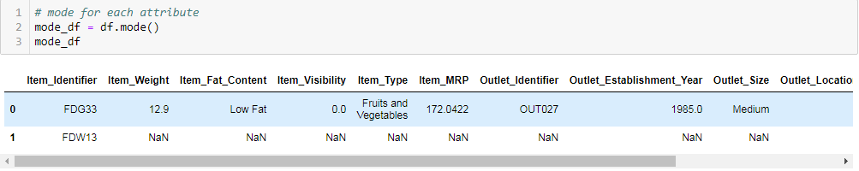
Mode:
The mode of a set of data values is the value that appears most often.
We can calculate the mean of each attribute using the mode() function on the Pandas DataFrame.

Slide 12
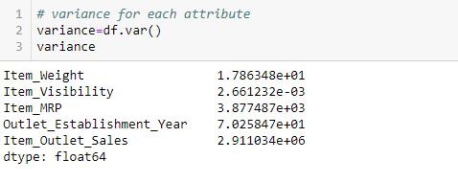
variance:
variance( ) function helps to calculate the variance from a sample of data (sample is a subset of populated data).
variance( ) function should only be used when variance of a sample needs to be calculated.
variance is the squared deviation of a variable from its mean.

Slide 13
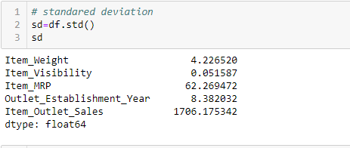
Standard Deviation:
Standard deviation used to quantify the measure of spread, variation of a set of data values.
It is very much similar to variance, gives the measure of deviation whereas variance provides the squared value.

Slide 14
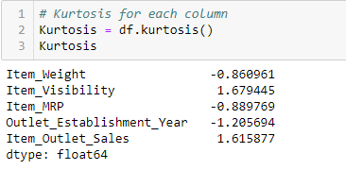
Kurtosis:
kurtosis is a statistical measure that is used to describe the distribution
kurtosis measures extreme values in either tail.
Distributions with large kurtosis exhibit tail data exceeding the tails of the normal distribution
Distributions with low kurtosis exhibit tail data that is generally less extreme than the tails of the normal distribution

Slide 15
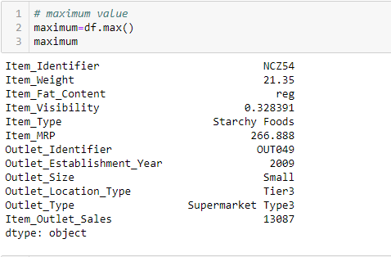
Maximum:
We can calculate the maximum value of each attribute using the max() function on the Pandas DataFrame.

Slide 16
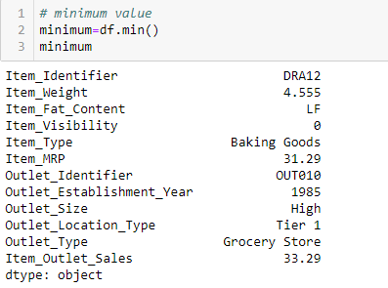
Minimum:
We can calculate the maximum value of each attribute using the max() function on the Pandas DataFrame.

Slide 17
Thank you

